Slide 1
Coursera Capstone Project – Battle of the Neighborhoods (Week 2)
Exploration and analysis of the venues in the neighborhoods of Philadelphia and Toronto using FourSquare venue data

Slide 2
Background: Philadelphia
has many universities and colleges make it a top study destination
estimated gross metropolitan product of $490 billion in 2019.
Twelve Boroughs of Philadelphia a hot spot for new residents, travelers and businesses.
Center City, South Philadelphia, Southwest Philadelphia, West Philadelphia, Lower North Philadelphia, Upper North Philadelphia, Bridesburg-Kensington-Port Richmond, Roxborough-Manayunk, Germantown-Chestnut Hill, Olney-Oak Lane, Near Northeast Philadelphia and Far Northeast Philadelphia.

Slide 3
Background: Toronto
International center for business, finance, arts and culture
The provincial capital of Ontario.
Toronto is also an education and economic hub with diversified strengths in technology, design, food services, education and many more.
This makes the ten boroughs a hot spot for new residents, travelers and businesses much like Philadelphia.
The ten boroughs that make up Toronto:
North York, Downtown Toronto, Etobicoke, Scarborough, East York, York, East Toronto, West Toronto, Central Toronto, Mississauga.

Slide 4
Problem & interest
This project will focus on how this data can be used to find new insights required for business opportunities in certain neighborhoods, cluster and segment venues to provide for a better user experience.
Various parameters to explore and evaluate correlation on businesses ratings on Foursquare
Comparison of the two cities
Interested parties might include business start-ups, stakeholders, and existing owners.
Business start-ups might be looking for areas that lack certain categorical venues to further enhance a neighborhoods overall experience.
Stakeholders can see how their invested interests are performing as a whole within city neighborhoods and to another city.
Existing business will also benefit to see how the venues likes, tips and photos will bring effectiveness on their price tie and ratings.

Slide 5
Data
Data Scraped from Wikipedia
Toronto Neighborhoods data:
Philadelphia Neighborhoods Data:
Location information provided by Geopy and Geolocator python libraries
Latitude and Longitude coordinates
Data for Venues provided by FourSquare
Regular calls for exploration of venues in vicinity of location information provided for each borough. Limit = 99,500
Premium calls for Venue information
Note on Limitations:
Ratings not always available for all called venues
Must limit to the 500 calls provided for premium

Slide 6
Methods
Overall frequency table
how many neighborhoods make up each borough
overall percentage that borough contributes to the cities total neighborhood count.
Foursquare’s premium calls
utilize the information on user likes, tips, photo counts, rating and distance to see if there are any correlations that exist between these variables.
Top 10 venue categories in each borough to observe the frequency distribution
Find what venue categories the borough is lacking.
K-means algorithm
cluster and segment our venues based on tips, photo counts, ratings, user likes and even distance.

Slide 7
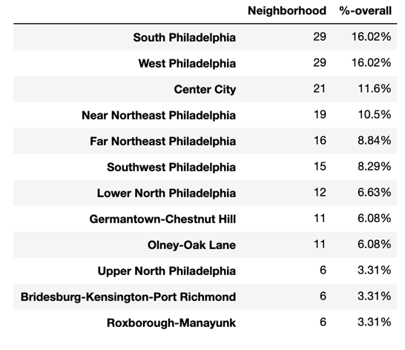
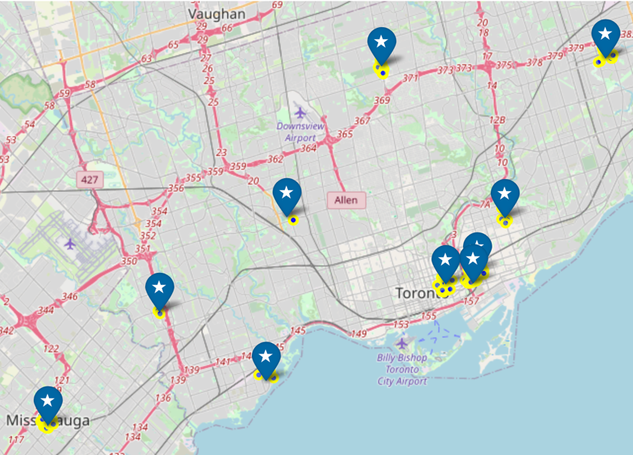
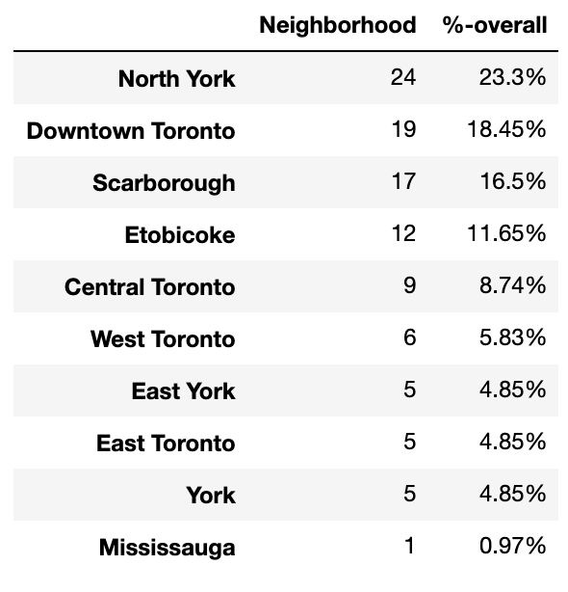
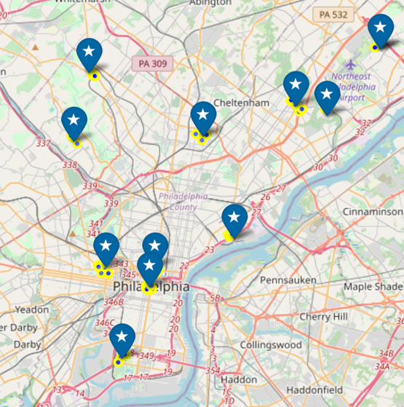
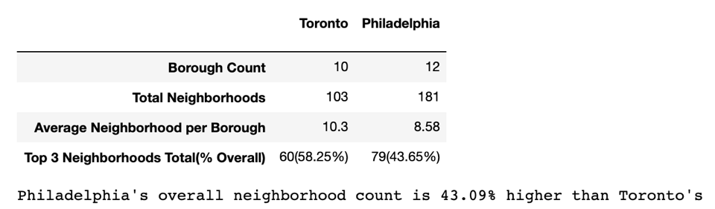
Neighborhood Comparison
Toronto
Philadelphia

Slide 8
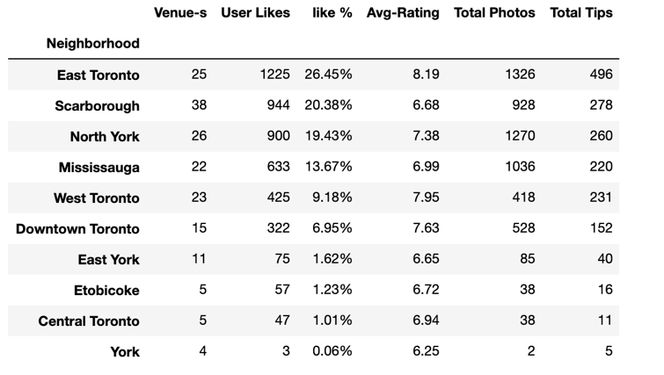
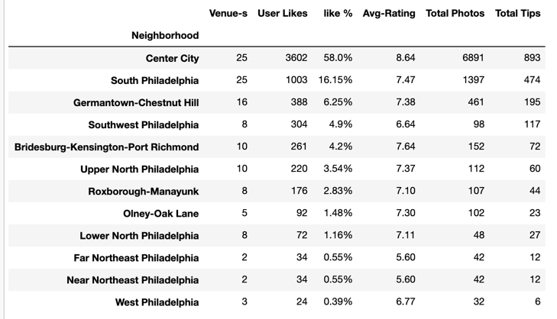
VenuE Comparison
Toronto
Philadelphia
Toronto has 26.45% of it’s overall likes from venues within East Toronto, 20.38% in Scarborough, and 19.43% in North York.
Philadelphia has 58% of it’s overall likes located in Center City and 16.15% in South Philadelphia. Philadelphia has much more drastic separation of ratings for venues.

Slide 9
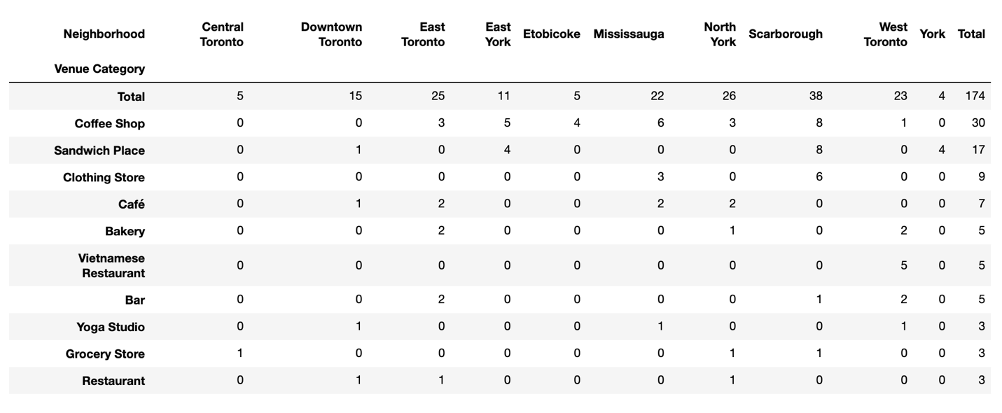
Top 10 Venue Category – Toronto
Areas where there are zeros could be potential business opportunities
The top 5 consist of Coffee Shops, Sandwich places, Clothing Stores, Cafes and bakeries.

Slide 10
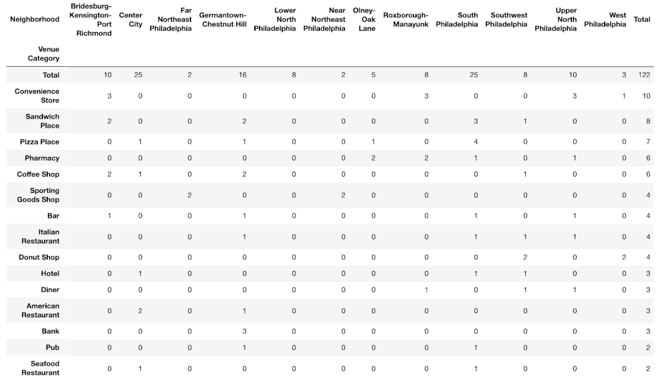
Top 10 venue Category - Philadelphia
Areas where there are zeros could be potential business opportunities
The top 5 consist of Convenience Stores, Sandwich Places, Pizza Places, Pharmacy and Coffee Shops

Slide 11
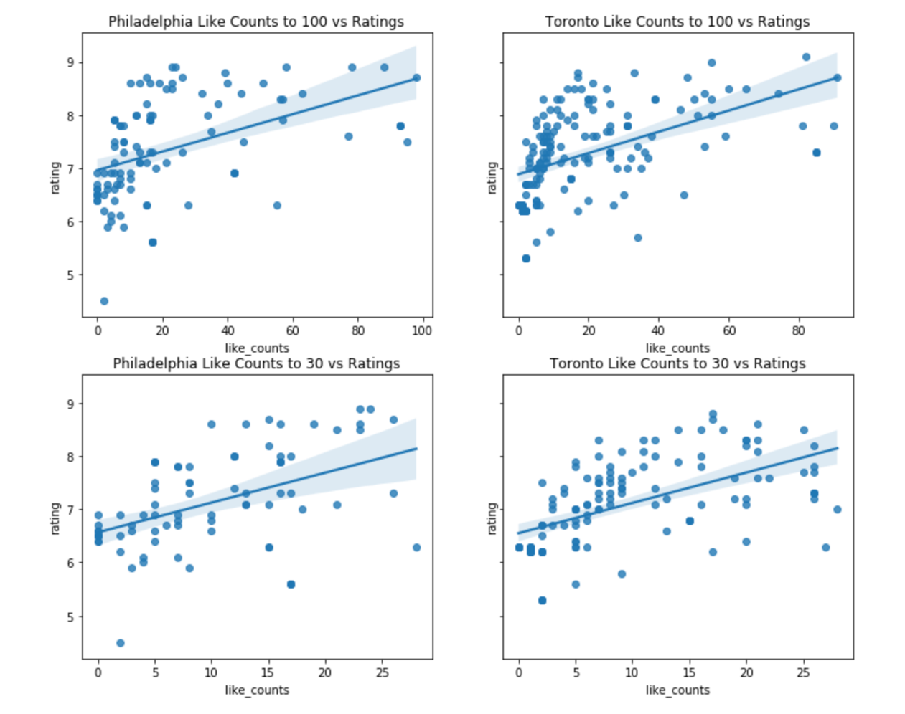
Correlation: Likes vs Ratings
Confining the area of observation to smaller counts (to remove outliers)
Both majorities at 100 like count max and 30 like count max show strong positive correlations on the effect of ratings for venues

Slide 12
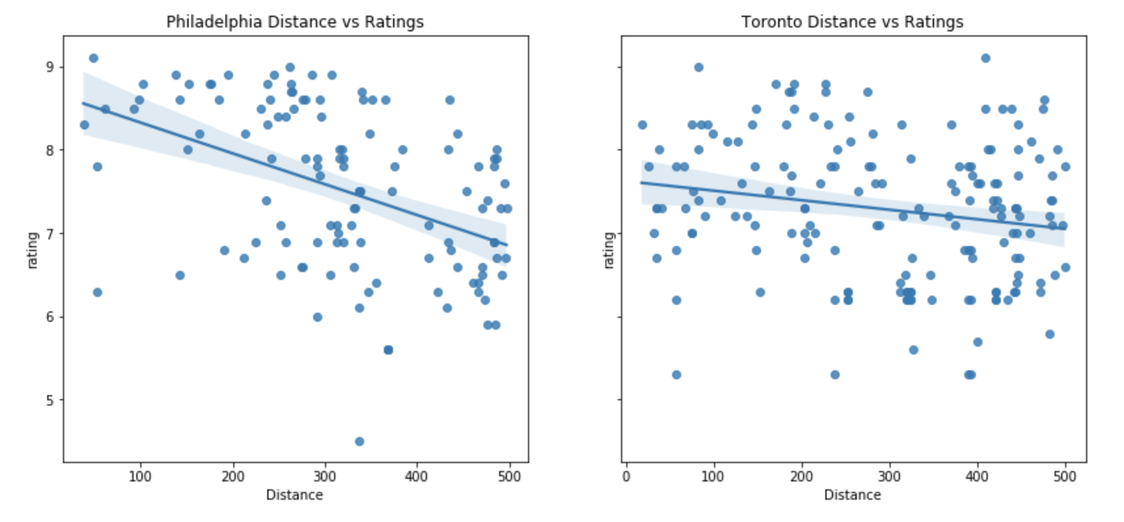
Correlation: Distance vs Ratings
Both cities distance from venue show negative correlations on the effect of ratings for venues

Slide 13
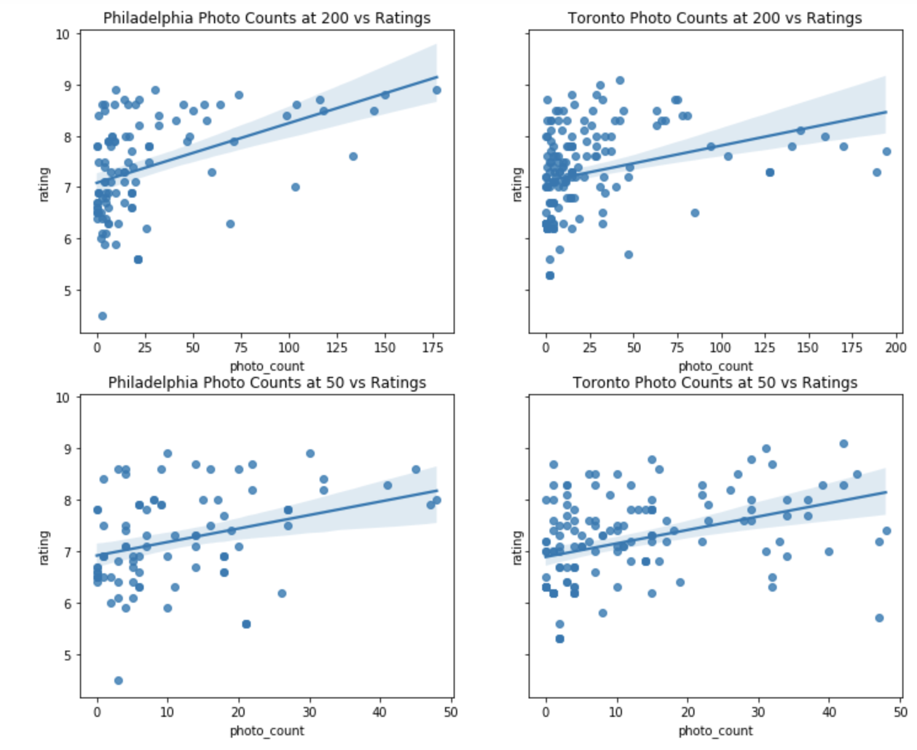
Correlation: Photos vs Ratings
Confining the area of observation to smaller counts (to remove outliers)
Both majorities at 200 photos max and 50 photos max show strong positive correlations on the effect of ratings for venues

Slide 14
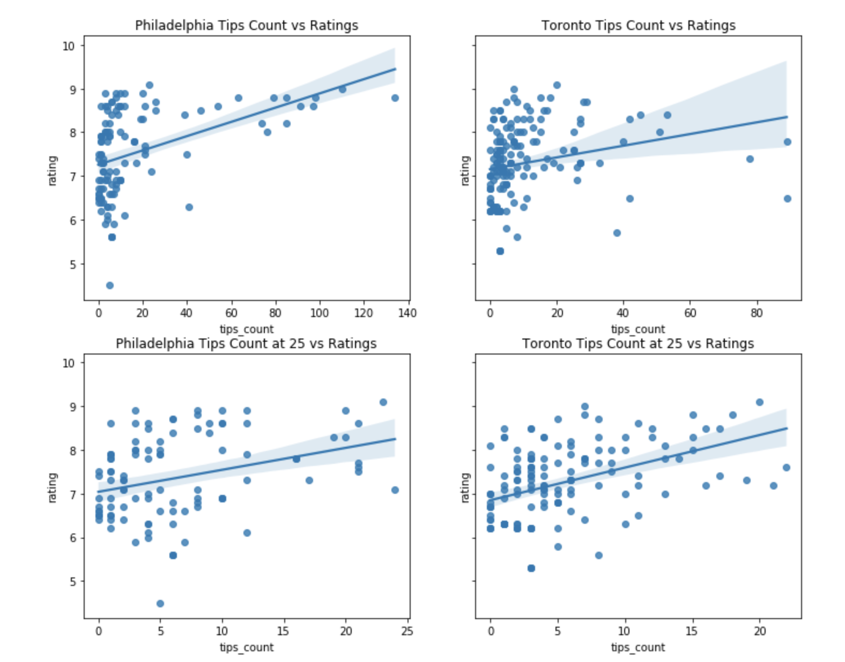
Correlation: Tips vs Ratings
Confining the area of observation to smaller counts (to remove outliers)
Both majorities at the overall tips count max and 25 tips count max show strong positive correlations on the effect of ratings for venues

Slide 15
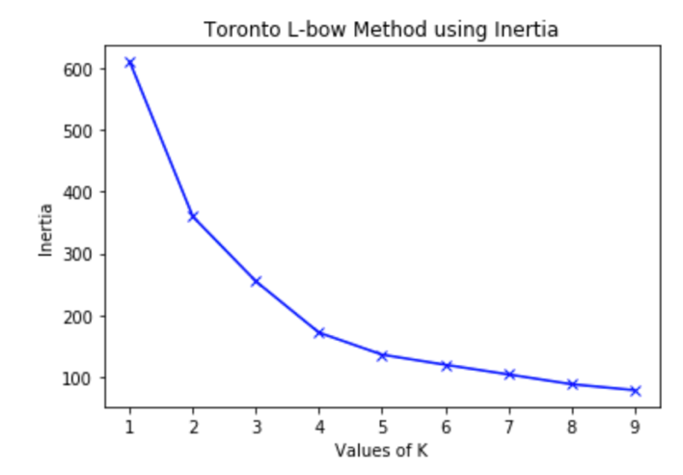
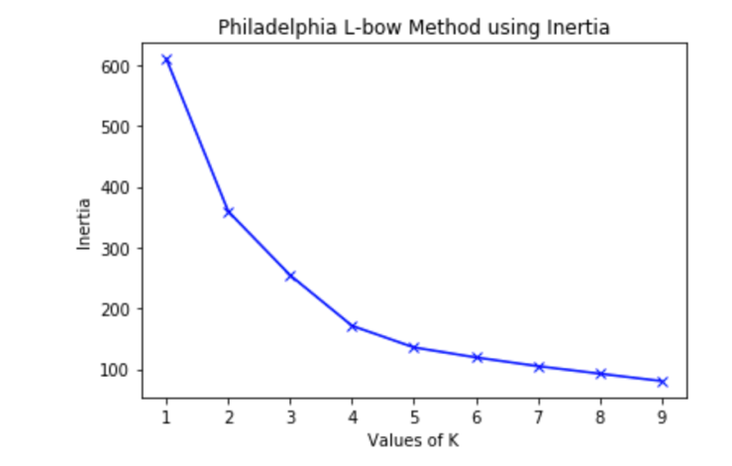
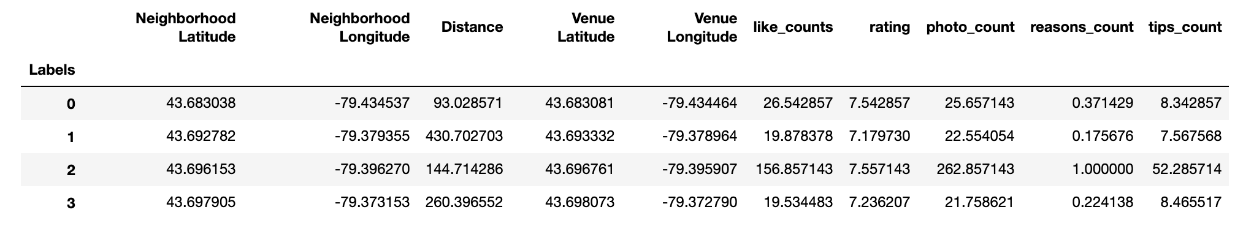
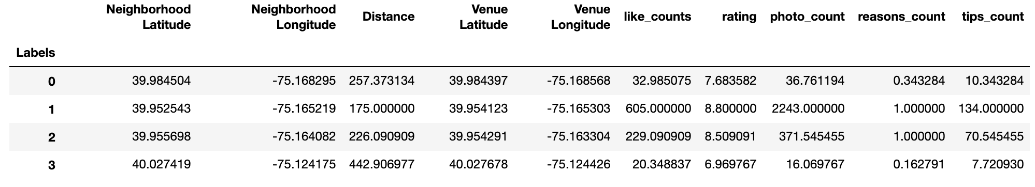
Clustering: K-means Evaluation
Toronto Mean Values for Cluster Centroids
Philadelphia Mean Values for Cluster Centroids
Elbow point to determine the number of clusters for the k-means algorithm to be 3-4
Means of each cluster centroid to so the overall of their

Slide 16
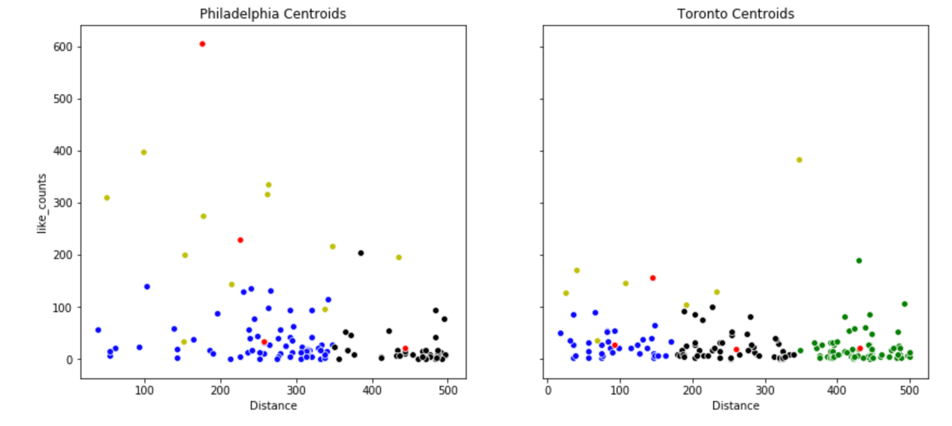
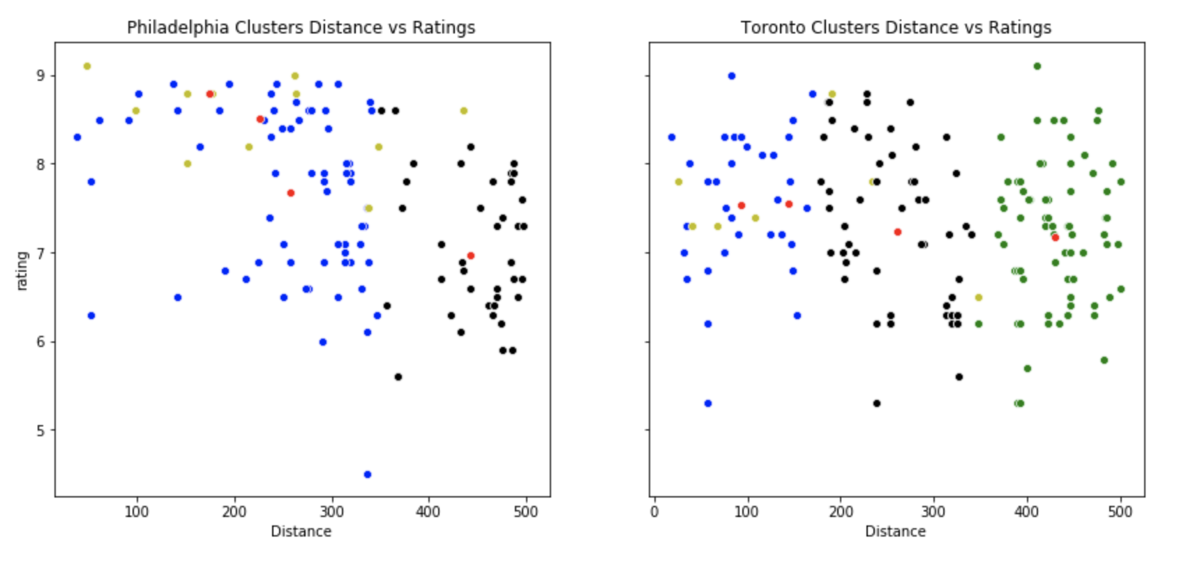
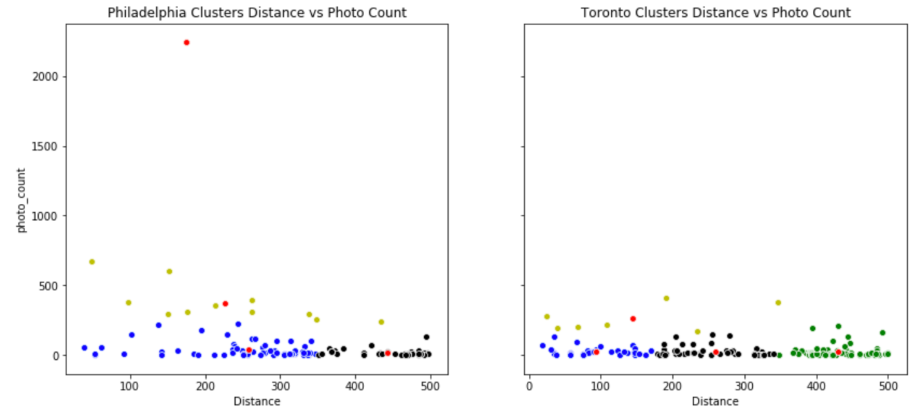
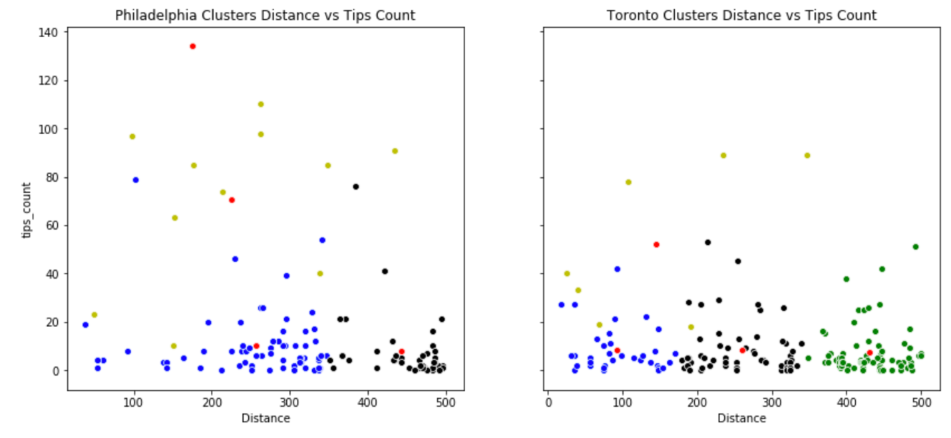
Clustering: K-means Evaluation
Cluster Label 2 (yellow) has a noticeably larger range than any of the other labels.
These might be hotpots within the city to observe and/or visit

Slide 17
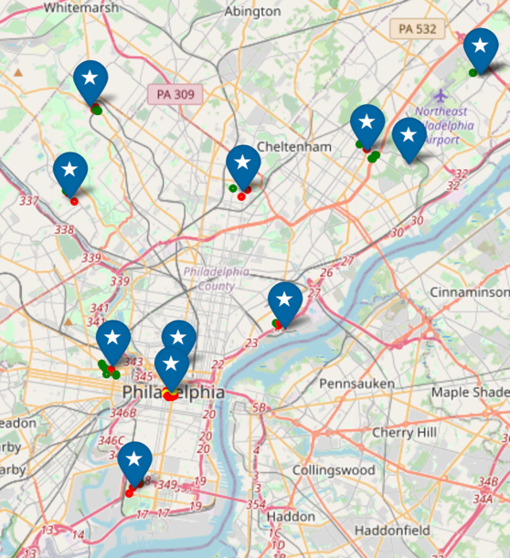
Clustering: K-means Clustering - Philadelphia
After
Before

Slide 18
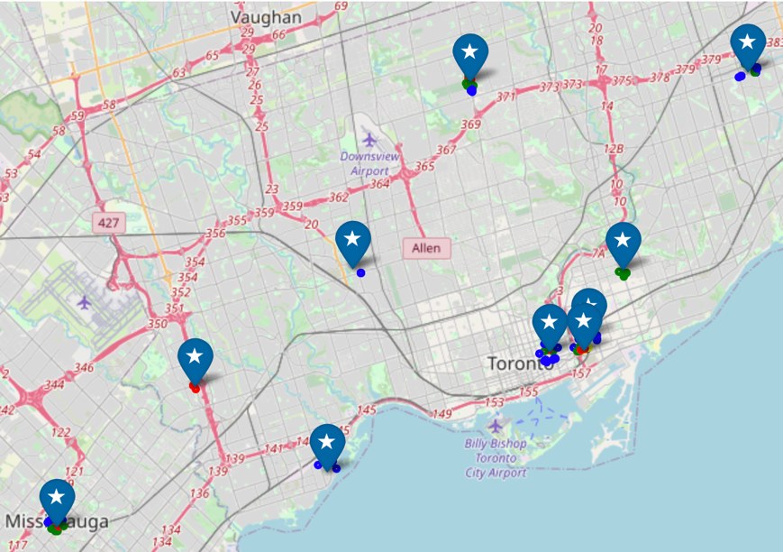
Clustering: K-means Clustering - Toronto
After
Before

Slide 19
Discussion
Our analysis of the venues at the boroughs within Philadelphia and Toronto observed:
the significance of venue likes, photo count and tips.
useful information for venue owners to mangers and can be driving factors when trying to promote or establish new business
Segmentation of these venues based on these significant parameters will improve the user experience at these venues as well.
Demonstrated the top categories in each of the boroughs
provide a clear indicator to recommend business owners and startups where popular locations may be to start new business.
Most likely limited to no venues in a borough that has potential for growth.
When comparing the two cities we see that Philadelphia has more neighborhoods within its limits than Toronto.
58% of the likes consist from Center City alone,
Toronto has a more even distribution of likes between their top neighborhoods
East Toronto, Scarborough, and North York.

Slide 20
Discussion (Con’t)
We demonstrated in the regression analyses:
ratings are positively correlated with likes, photo count and tips for each
Ratings are negatively correlated with distances.
Important for exploring ways to improve upon existing or new businesses.
The clustering of our venues in the boroughs gave us insight for Philadelphia and Toronto
Most likes, ratings, photo count and tip counts were not affected by the distance
Cluster label 2, as they had a tendency to have their values range higher than the rest despite of distance.
Might be the hotspots for activity in their Boroughs and can provide means for people to evaluate and visit these venues.

Slide 21
Conclusion
Explored Effectiveness of distance, photos, tips, ratings and likes.
We compared the venues, boroughs and neighborhoods
Revealed a strong positive correlation to ratings when observing likes, photos and tips for both cities. We observed a negative correlation with distance.
While there are some limitations to this project, as larger data from Foursquare cannot be pulled without higher access and not all data pulled contains information for our venues that’s required for the analysis.
Overall, we have established a working model that can only improve evaluation of venues and boroughs for potential locations for start-ups, business ventures and even travel hot spots as more information is made available.

